Slide 1


Slide 2
Project Jupyter

Slide 3
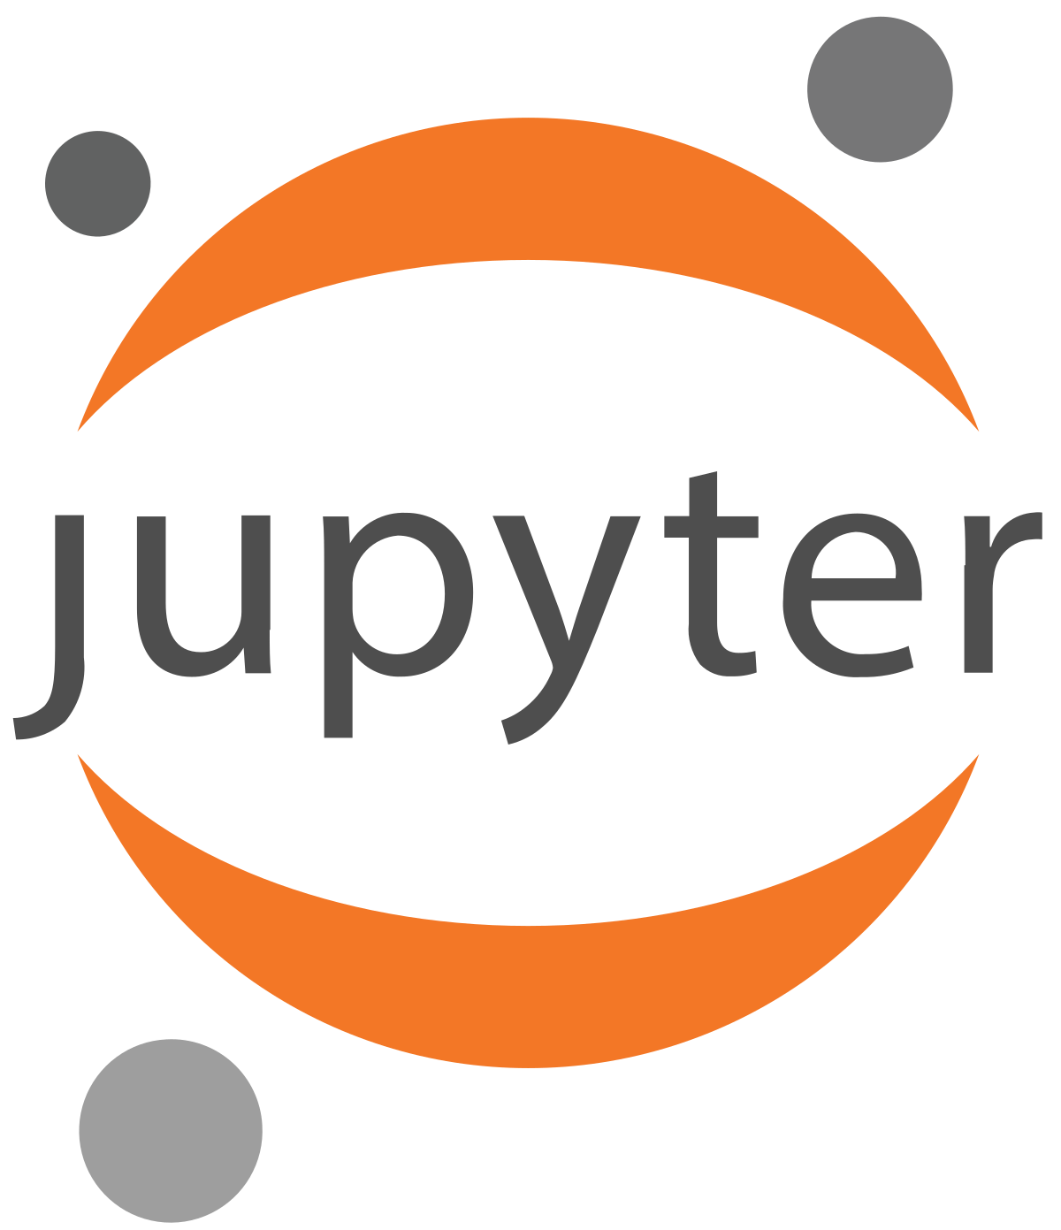
Project Jupyter - History
a non-profit, open-source project
IPython was released in 2011
born out of the IPython Project in 2014
IPython continues to exist as a Python shell and a kernel for Jupyter
support interactive computing, research and education
with an emphasis in data science workflows
will always be 100% open-source software, free for all
released under the liberal terms of the modified BSD license
Its name and logo are an homage to Galileo's discovery of the moons of Jupiter
three core programming languages supported by Jupyter are Julia, Python and R
Jupyter supports over 40 programming languages
Project Jupyter has developed and supported the interactive computing products Jupyter Notebook, JupyterHub, and JupyterLab
A $ 6 million dollars grant in 2015, donations, sponsors, awards, …
about 200,000 Jupyter notebooks on GitHub in 2015
about 2.5 million Jupyter notebooks on GitHub in 2018
nearly 10 million Jupyter notebooks on GitHub in 2021
Major cloud computing providers have adopted the Jupyter Notebook or derivative tools as a frontend interface for cloud users
Amazon SageMaker Notebooks, Google's Colaboratory, and Microsoft's Azure Notebook
As of July 2022, the Jupyter extension for VS Code has been downloaded over 40 million times, making it the second-most popular extension in the VS Code Marketplace
In 2021, Nature named Jupyter as one of ten computing projects that transformed science

Slide 4
^Jupyter*
What’s the Difference Between Jupyter Notebook, JupyterLab, and JupyterHub?
Jupyter Notebooks provides a document specification and a graphical user interface for editing documents.
Here are several aspects to know about Jupyter Notebooks:
  A Jupyter Notebook is a .ipynb specification document file—composed of narrative text, code cells, and outputs.
  A Jupyter Notebook comes with a graphical user interface—which enables you to edit .ipynb documents.
  Document editing is not exclusive to the Jupyter Notebook interface. You can also use alternatives like JupyterLab, Google Colab, nteract, and Kaggle.
JupyterLab provides a user interface designed for interactive computing.
Here are several aspects to know about JupyterLab:
  JupyterLab is a user interface—designed to provide extensible and flexible interactive computing.
  JupyterLab provides extensions—some of which are designed for Jupyter Notebooks. There are also extensions designed for specific parts of the data science pipeline.
JupyterHub provides an application designed for the management of Jupyter Notebooks.
Here are several aspects to know about JupyterHub:
  JupyterHub is an application—designed to help you manage multiple-users sessions of interactive computing.
  JupyterHub provides connectivity—that enables you to connect users with the infrastructure required for their sessions.
  JupyterHub enables remote access—to JupyterLab as well as Jupyter Notebooks. You can use this option to let multiple users gain remote access to Jupyter resources.

Slide 5
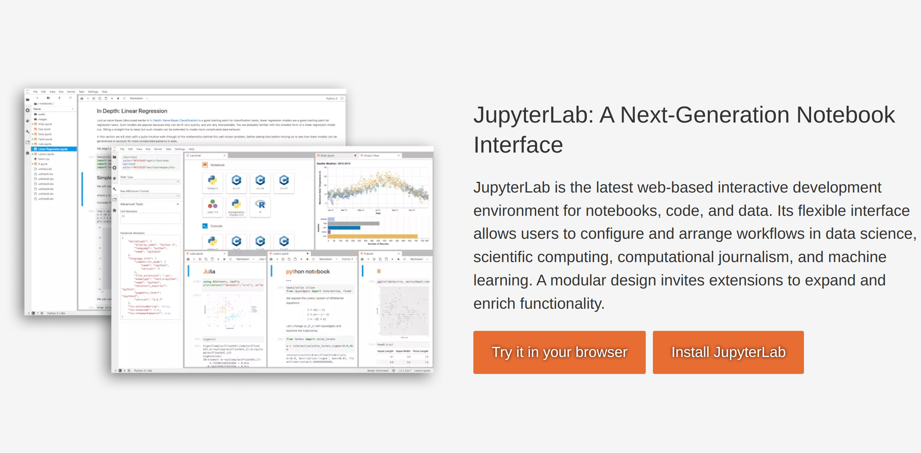
JupyterLab

Slide 6
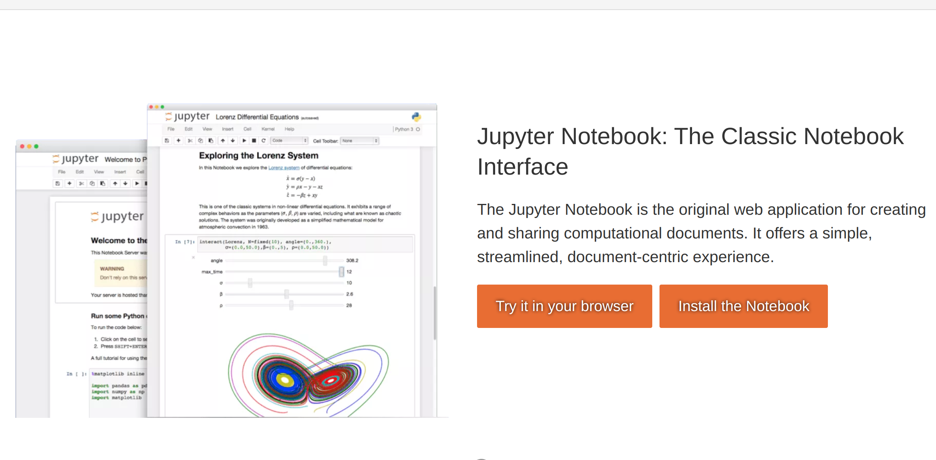
Jupyter Notebook

Slide 7
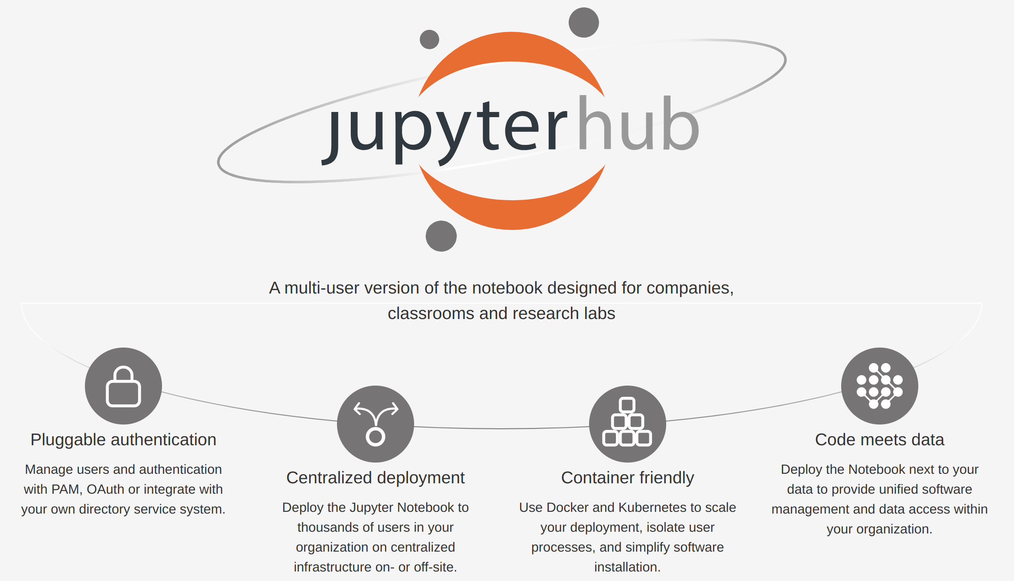
JupyterHub

Slide 8
How to Install Jupyter Notebook?

Slide 9
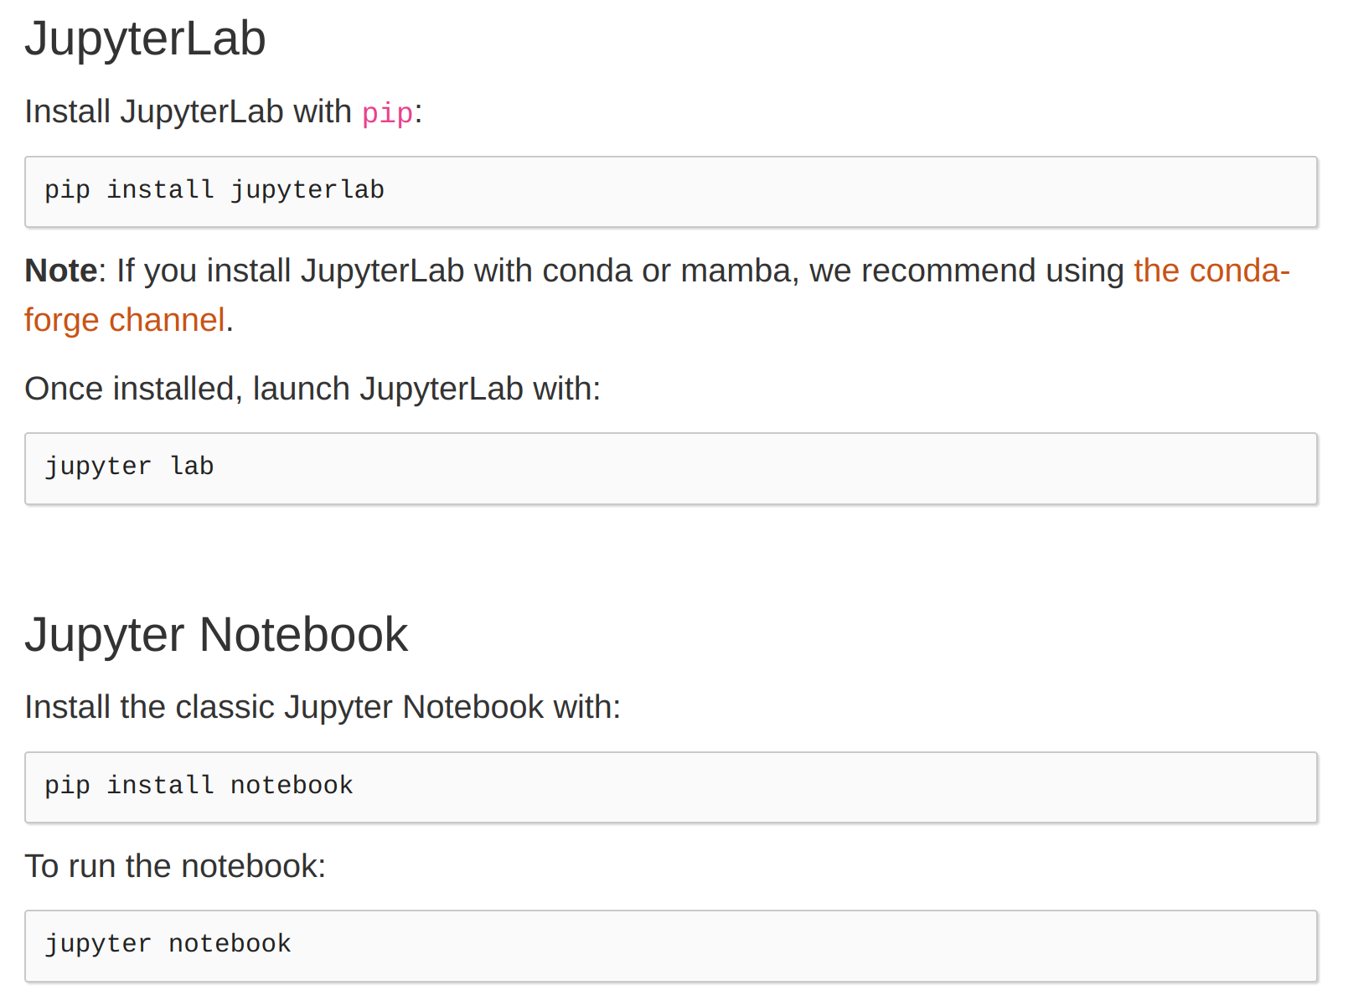
Installation
The simplest way

Slide 10
How to work with Jupyter Notebook?

Slide 11
Terminology
Kernel:
  A kernel is a “computational engine” that executes the code contained in a notebook document.
  Behind every notebook runs a kernel.
  When you run a code cell, that code is executed within the kernel.
  Any output is returned back to the cell to be displayed.
Cell:
  A cell is a container for text to be displayed in the notebook or code to be executed by the notebook’s kernel
    A code cell contains code to be executed in the kernel. When the code is run, the notebook displays the output below the code cell that generated it.
    A Markdown cell contains text formatted using Markdown and displays its output in-place when the Markdown cell is run.

Slide 12
Keyboard Shortcuts
Esc: command mode
Enter: edit mode
Up and Down: Scroll up and down
A: insert a new cell above
B: insert a new cell below
M: transform the active cell to a Markdown cell
Y: set the active cell to a code cell
D + D (D twice): delete the active cell
Z: undo cell deletion
Hold Shift and press Up or Down to select multiple cells at once
With multiple cells selected, Shift + M will merge your selection
Ctrl + Shift + - in edit mode, will split the active cell at the cursor

Slide 13
Markdown

Slide 14
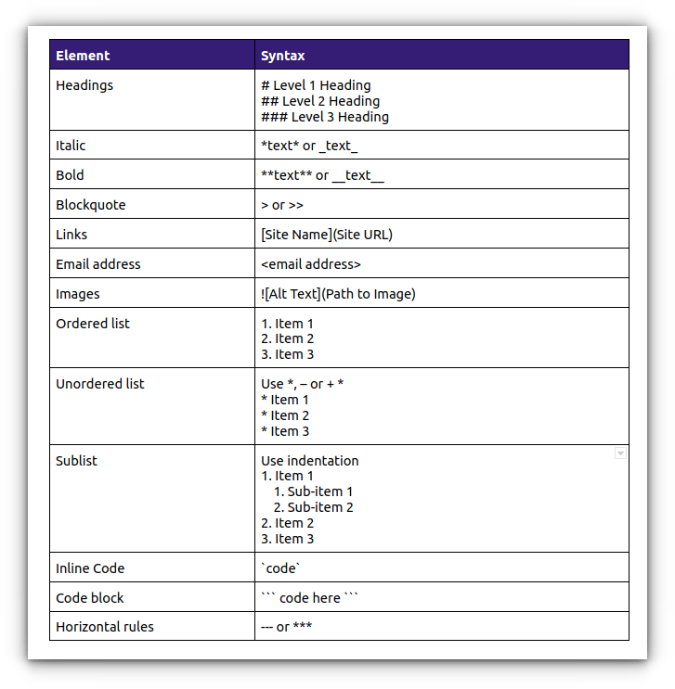
Markdown
John Gruber created Markdown in 2004
It is a lightweight, easy to learn markup language for formatting plain text without the use of a formal text editor or the use of HTML tags
Its syntax has a one-to-one correspondence with HTML tags.
Markdown is easier to write than HTML, and it's easier for most humans to read Markdown source than HTML source. However, HTML is more expressive.
Markdown is widely used for blogging and instant messaging, and also used elsewhere in online forums, collaborative software, documentation pages, and Readme files.
What is the difference between markup and markdown?

Slide 15
Save, Export, Share

Slide 16
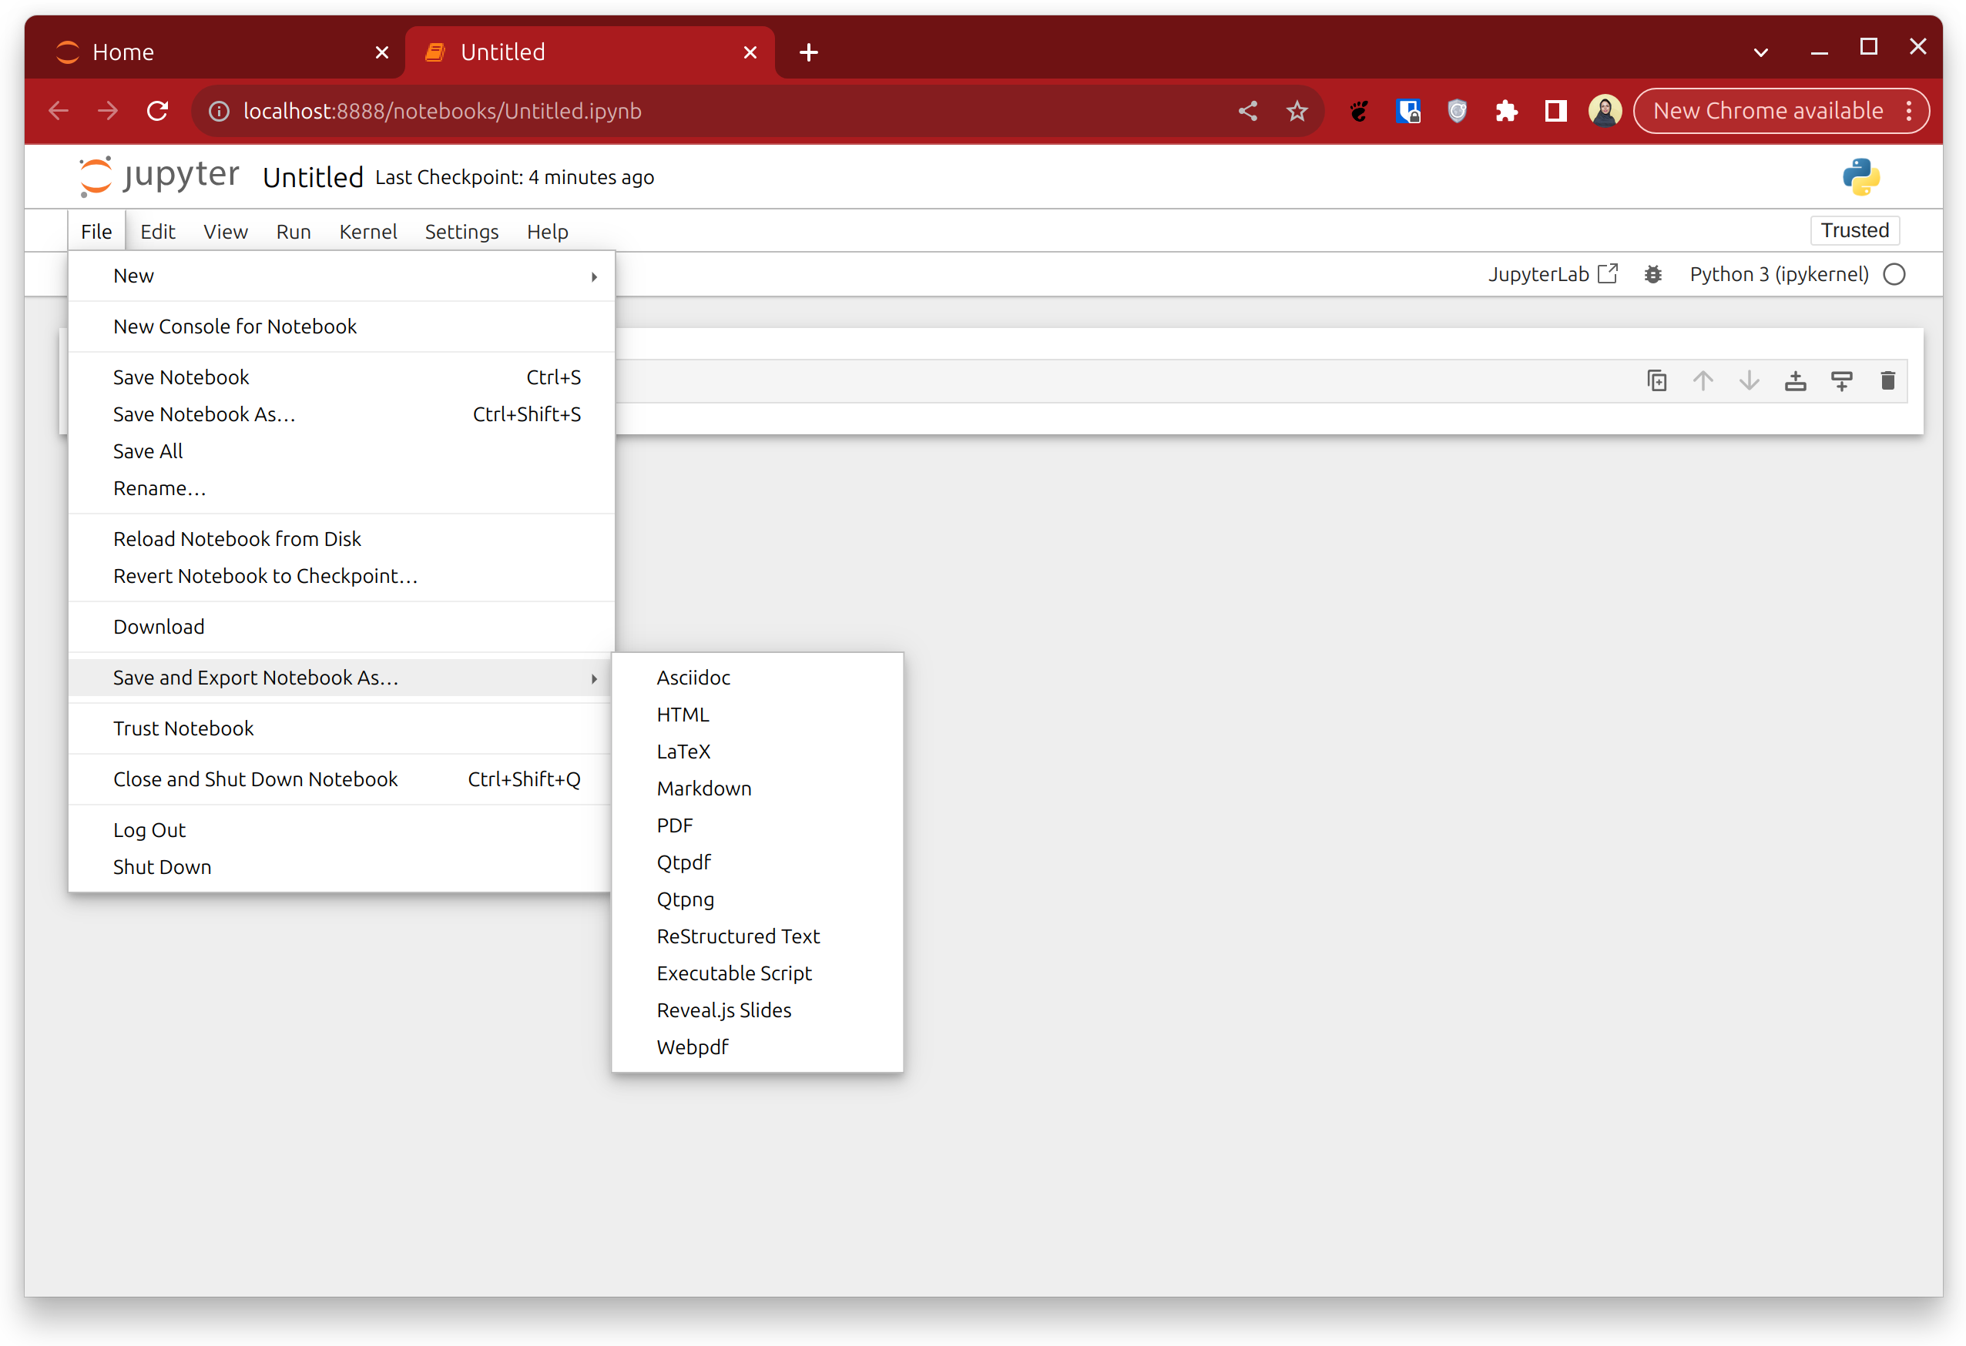
Save it as you wish!

Slide 17
Let’s see some examples! :)

Slide 18


Jupyter Notebook - By Maryam Behzadi
Created with Love by LibreOffice Impress

